Slide 1
AI is coming for you: New Biometric Leadership in the era of Gen AI
Kevin Lee

Slide 2
Disclaimer
The views and opinions presented here represent those of the speaker and should not be considered to represent any companies or organizations.

Slide 3

Agenda
Gen AI is coming
Why Gen AI in Biometric Leadership?
Gen AI Implementation Leadership ( System, Process & People)
Leading into the future
Discussion

Slide 4

As a Child, have you ever dreamed something was coming at you?

Slide 5

Nowadays, Just like our Childhood dream, something big, unstoppable is coming at our works.
Gen AI

Slide 6
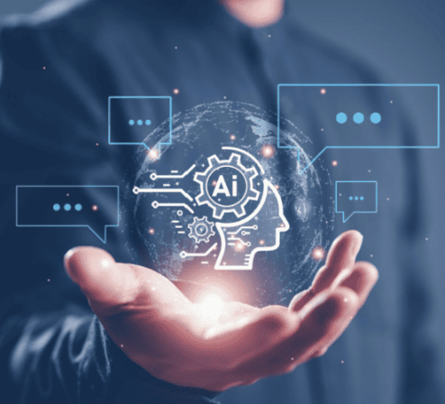
If Gen AI is coming,
How can we lead this big and unstoppable wave?
What kind of leadership do we need to practice?

Slide 7
Why is Biometrics Leadership important in Gen AI era?
Competitive Necessity: Avoid falling behind more agile, AI-adopting competitors
Strategic Opportunity: First movers gain outsized benefits and industry influence
Organizational Imperative: Leadership has the authority to implement meaningful change
Resource Justification: Executive sponsorship secures critical investments
Risk Management: Leadership oversight needed for regulatory and compliance challenges
Talent Motivation: Teams look to leadership for vision during AI-driven transformation

Slide 8
People
Process
System
Definition of Leadership
Leadership is defined as
“the ability
to cultivate the environment,
guide the process,
empower people
to achieve a shared vision and drive common goals”

Slide 9
Gen AI Tools / Systems in Biometrics
- Identifying Gen AI tools
- Integrating with existing infrastructure
- Validation framework
- Compliance and Integrity

Slide 10



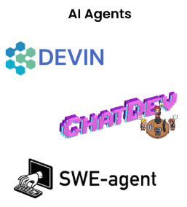



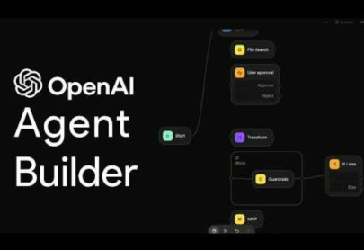

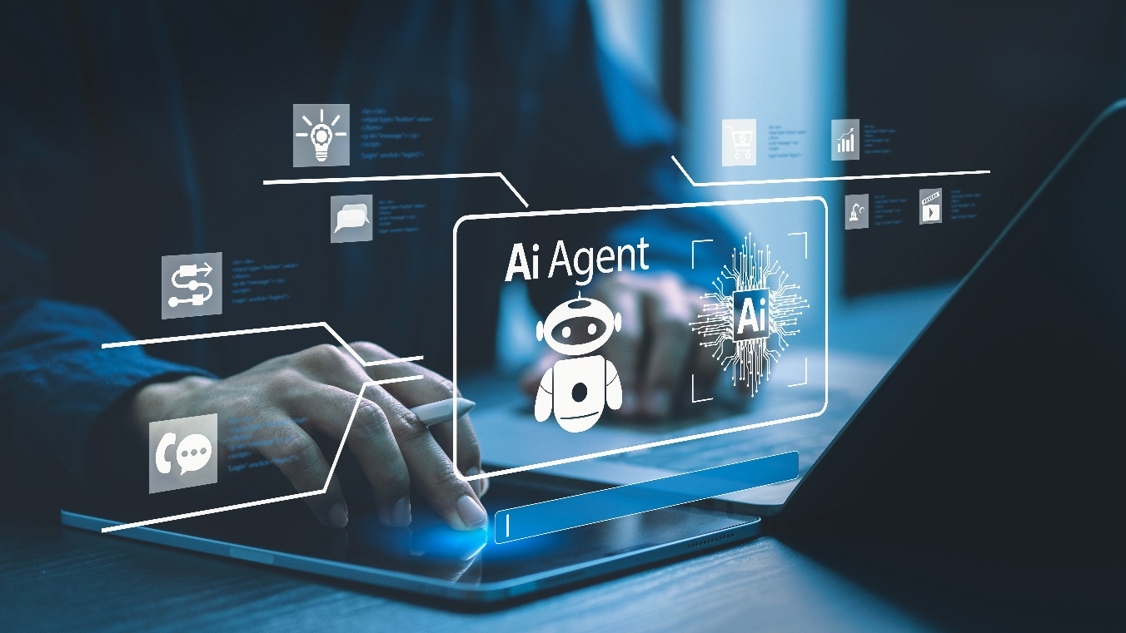

Gen AI Tools / Systems

Slide 11
Integration with existing infrastructure
Gen AI tools / system
Existing tools/infrastructure ( e.g., SCE, EDC, MDR, CDR)

Slide 12
Validation framework
Regulatory Importance: Gen AI outputs must meet the same quality standards as traditionally produced results.
Biometrics Leadership Role: Must establish rigorous, risk based validation protocols/systems tailored for Gen AI implementation.
Framework Components:
  Risk-based validation planning
  Verification of AI-generated output accuracy
  Application of GxP / GAMP 5 principles
  Comprehensive documentation (requirement, process, test scripts, reports)
  Version control and audit trails

Slide 13
Gen AI Tools
Existing Systems
Validation
Ecosystem with traceability, accuracy, consistency, and compliance
Gen AI integrated, compliant Biometric ecosystem roadmap

Slide 14
Gen AI Process Roadmap
- Validation & QC
- End to End Current Process Redesign
- Human & AI Collaboration
- Regulatory Strategy

Slide 15
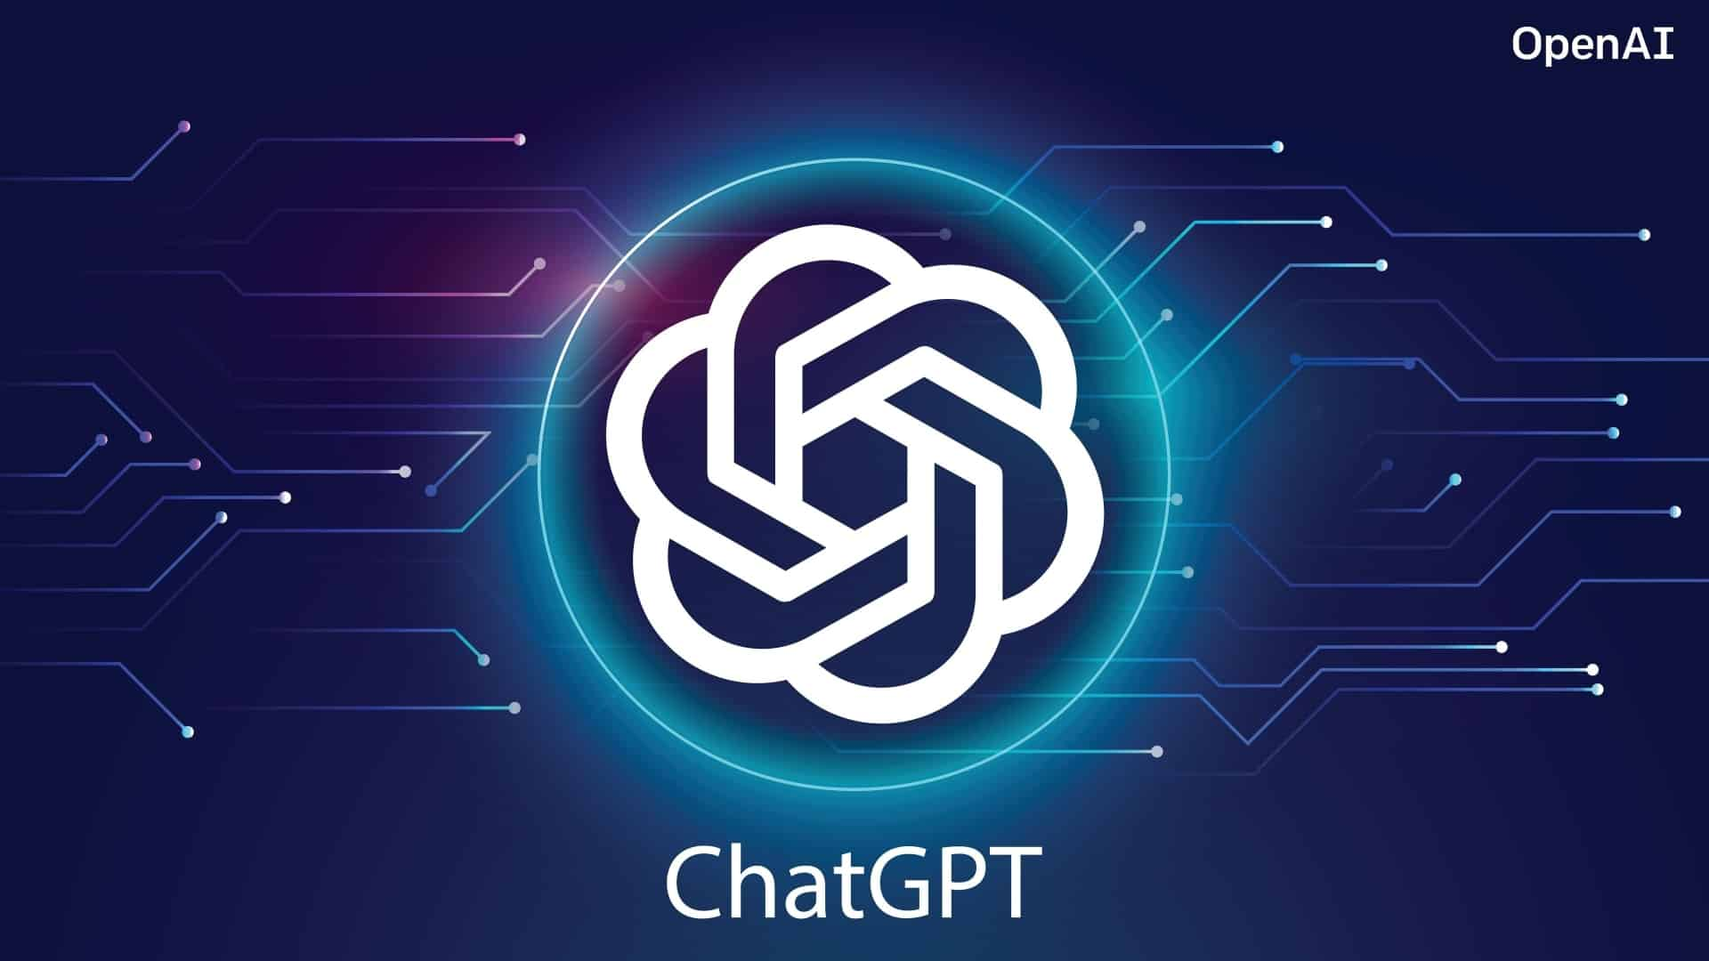

ChatGPT is like a very smart, capable, recently graduated intern/new hire.

Slide 16

What will we do with the outputs from an intern’s work?
Notes:
If I get the output from Gen AI / ChatGPT / Smart Intern, will I just hand it over considering it as

Slide 17
Input data
Gen AI Output
Human Intervention
Gen AI tool
Final Result
Gen AI driven Process
The output of Gen AI is
not the final result,
but the beginning of new process.

Slide 18
End-to-End Process Redesign with Gen AI Integration
Comprehensive Review: Biometrics leadership should review the entire biometric process
  study design
  database lock
  submission.
Identify Opportunities: Focus on high-impact areas where Gen AI can be integrated to add value.
Systems Efficiency Thinking: Apply a holistic approach to streamline processes and reduce inefficiencies.
Goal: Improve overall efficiency and effectiveness of biometric workflows through Gen AI integration.

Slide 19
Human vs AI Collaboration Strategy
AI Automation
Human Intervention
Clear delineation
  AI-driven activities
  Human-driven activities
AI roles
  Assistant: e.g., generating initial code or report templates
  Autonomous Operator: e.g., handling routine quality checks or standardized visualizations
Human intervention- required to ensure oversight and accountability.

Slide 20
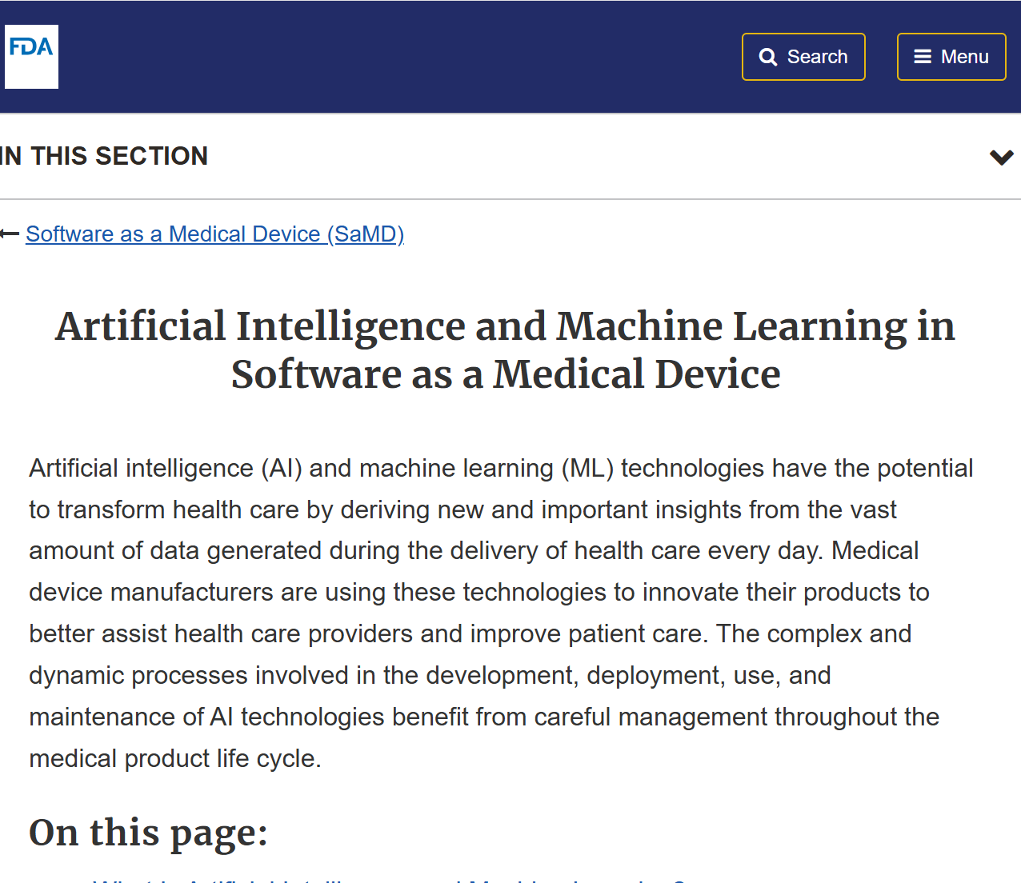
Regulatory Strategy
Forward-thinking leadership
  Expecting evolving regulatory requirements
  Engaging proactively with authorities.
Key strategies:
  Preparing comprehensive documentation of validation approaches
  Developing SOPs, Working Instructions, and Guidelines for Gen driven process.
  Validating software packages used by AI tools to ensure regulatory compliance (e.g., R or Python packages )

Slide 21
People Empowerment
- Capability Building
- Culture Transformation
- Cross functional Collaboration

Slide 22
Comprehensive Capability Building
Assessment
Existing skill gaps
Implement targeted training initiatives.
Current State
In Gen AI Skills
Desired State
In Gen AI Skills
Focus areas for capability building:
  Technical proficiency with Gen AI tools (e.g., ChatGPT, Copilot)
  Prompt engineering
  Validation skills for AI-generated outputs
A systematic approach ensures department-wide readiness for Gen AI integration.

Slide 23
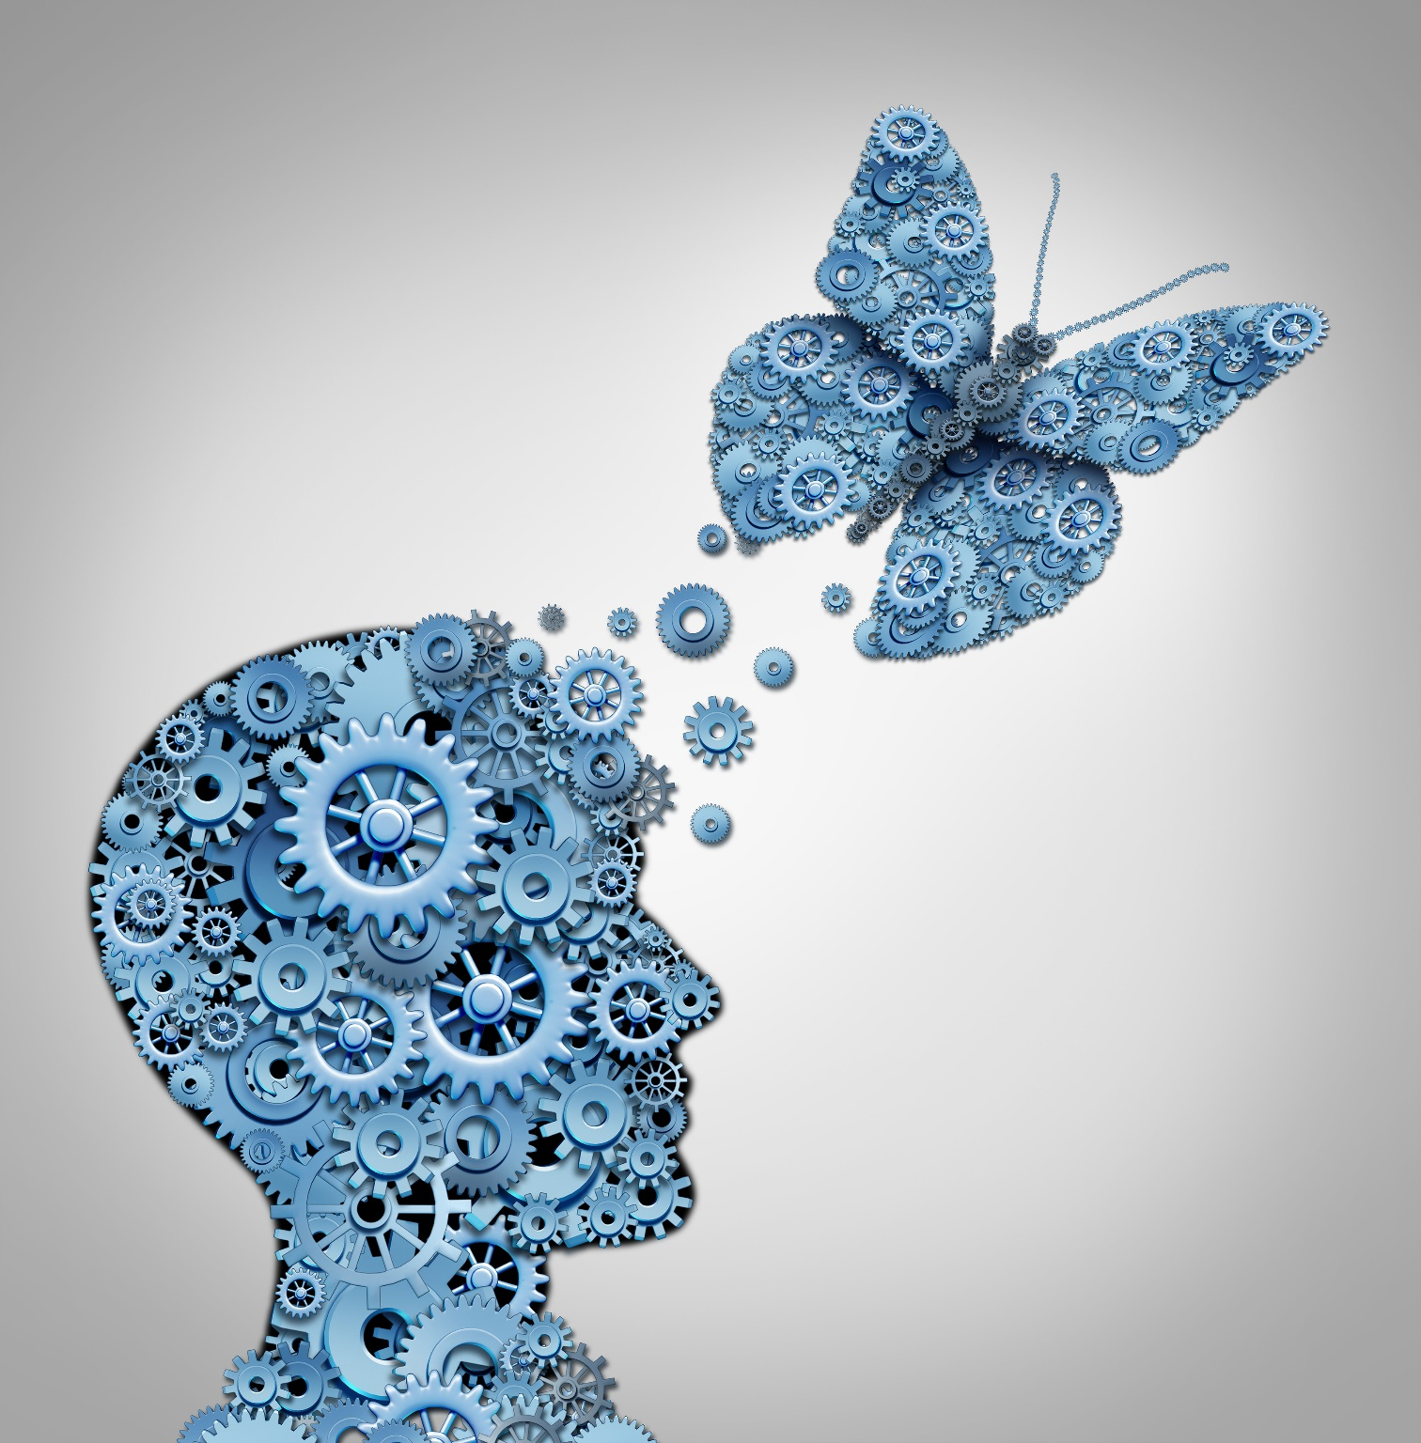
Culture Transformation
Foster psychological safety to encourage experimentation with Gen AI tools.
Promote a mindset of responsible innovation—where creativity thrives without compromising compliance.
Goals : To ensure continued commitment to regulatory compliance while embracing AI change.

Slide 24
Cross-functional Collaboration
Biometrics
IT
QA
Clinical Operation
Leadership
Clinical Development
CDM
Goals : Leading Gen AI implementation by addressing the needs of other functions

Slide 25
Leading into the future
- Super Biometric Team ( Avenger )

Slide 26



In a dream, something is coming at you >>> You are growing.

Slide 27

Gen AI Integrated System
Gen AI Process
People Empowerment
Gen AI powered “Super Biometrics Team (Avenger)”
Discussion :
AI is coming at us.
Is it our opportunity to grow with it?

Slide 28

Questions
Kevin Lee at kevin@clinvia.com
LinkedIn : https://www.linkedin.com/in/hellokevinlee

Slide 29
Appendix

