Slide 1
From Hundreds of Programs to One Program
Let SAS Write and Run SAS Programs
Ye Wang
Wharton Research Data Services (WRDS)
Presented at PhilaSUG Onsite Meeting, Oct 31st 2025

Slide 2
Plan
Presentation first without pause for questions
Q&A session follows
Slides and sample programs will be shared afterward

Slide 3
What I will Cover Today
  Share a real example from my work at the WRDS Data Team, where I developed a single SAS program to replace hundreds of individual SAS scripts.
  The new program automatically generates and executes SAS code based on two input datasets, and cleans hundreds of SAS datasets.

Slide 4
Some Background Information
About Wharton Research Data Services (WRDS)
  Part of the Wharton School
  500+ subscribers in 38 countries (mainly universities)
  About 80 data vendors
  CRSP, FactSet, LSEG, Moody’s, NYSE, S&P Global, SEC, …
  WRDS hosts data across all disciplines, including Accounting, Banking, Economics, ESG, Finance, Healthcare, Insurance, and etc., giving users the power to access and analyze complex information through different interfaces
  We provide researchers and students with data and tools
  We promote transparency in this world

Slide 5
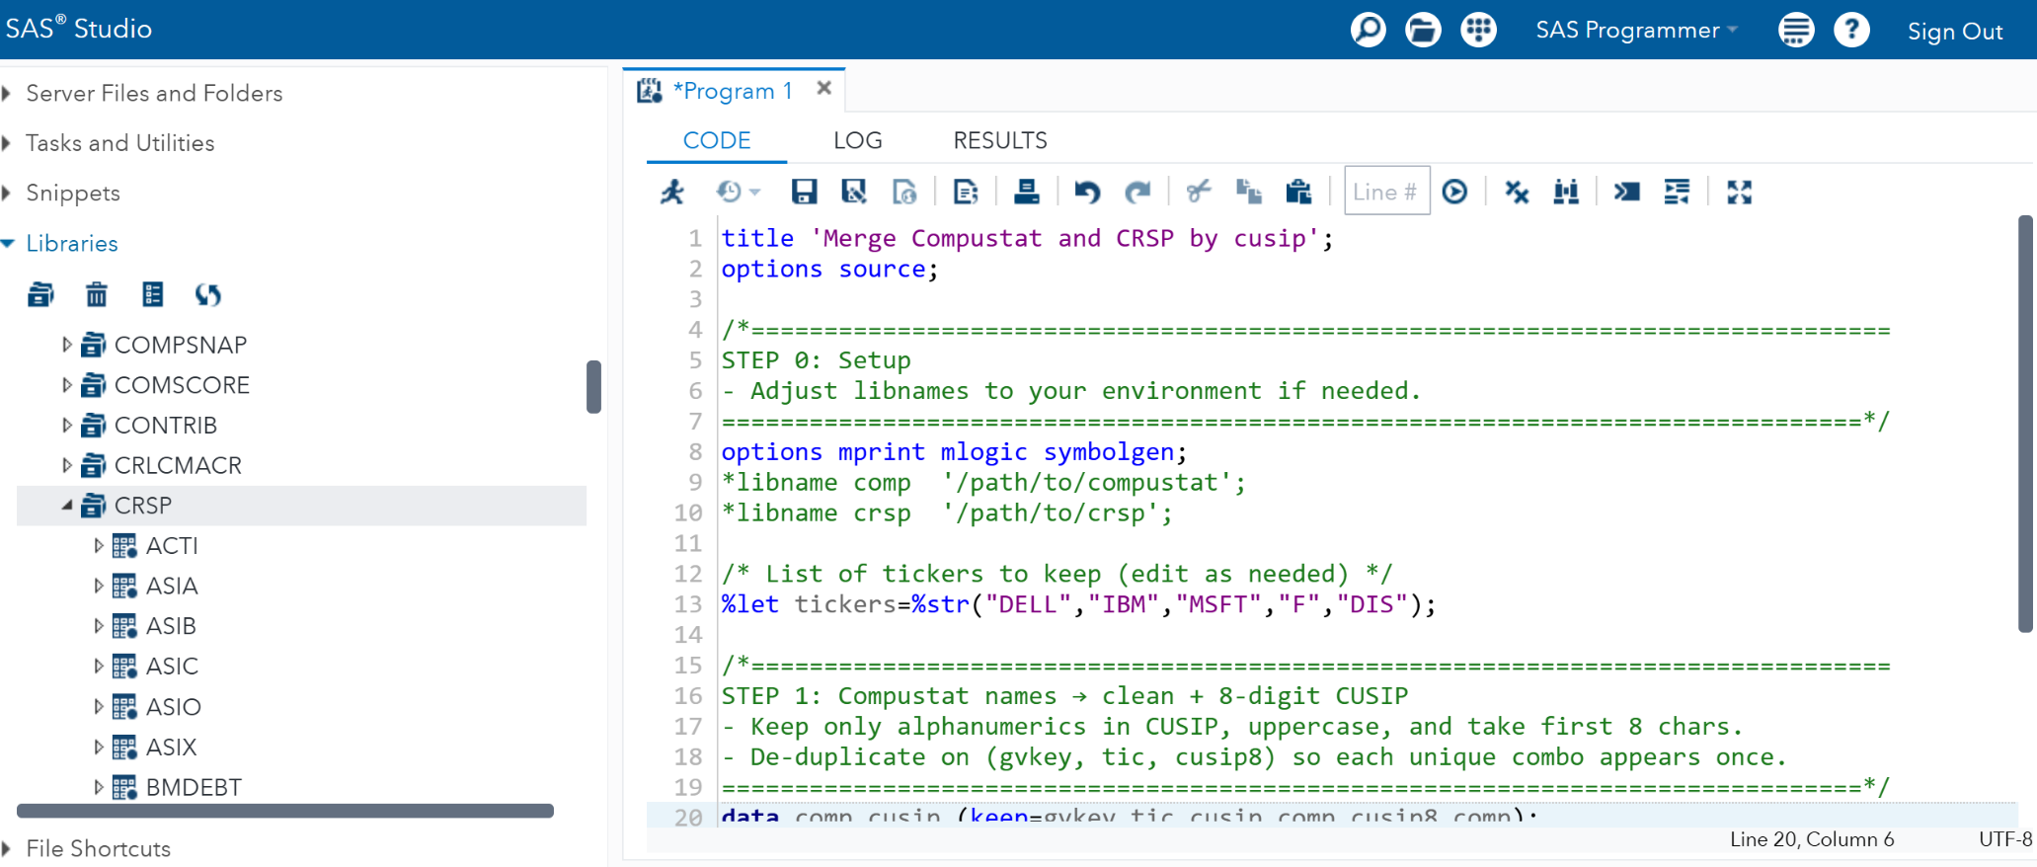
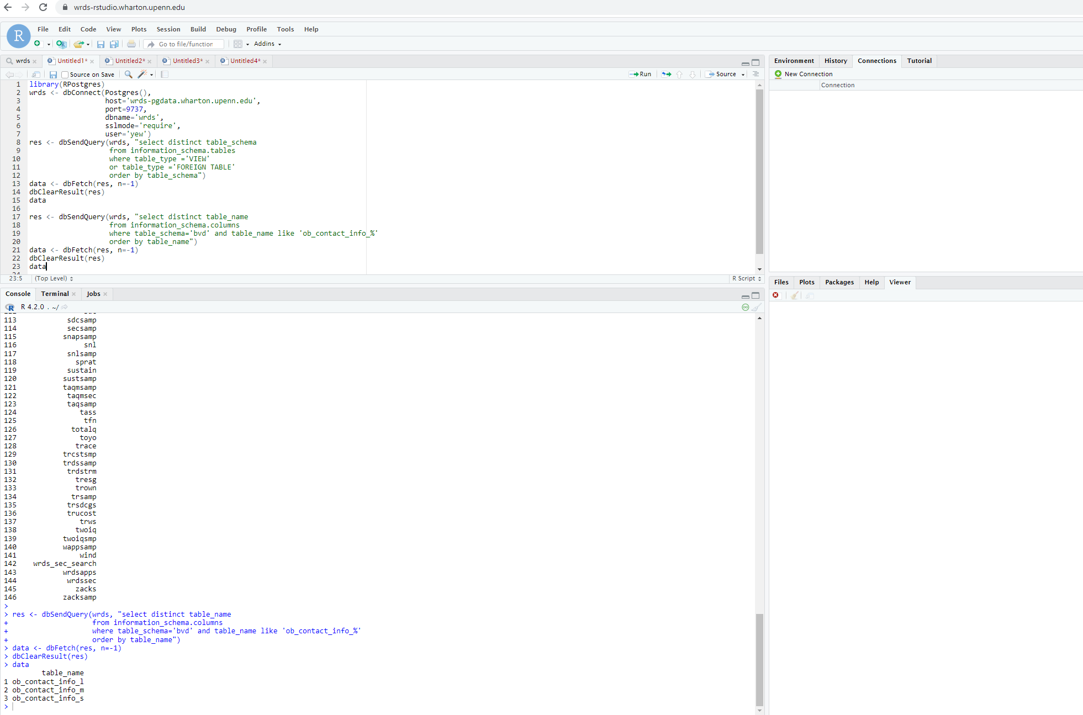
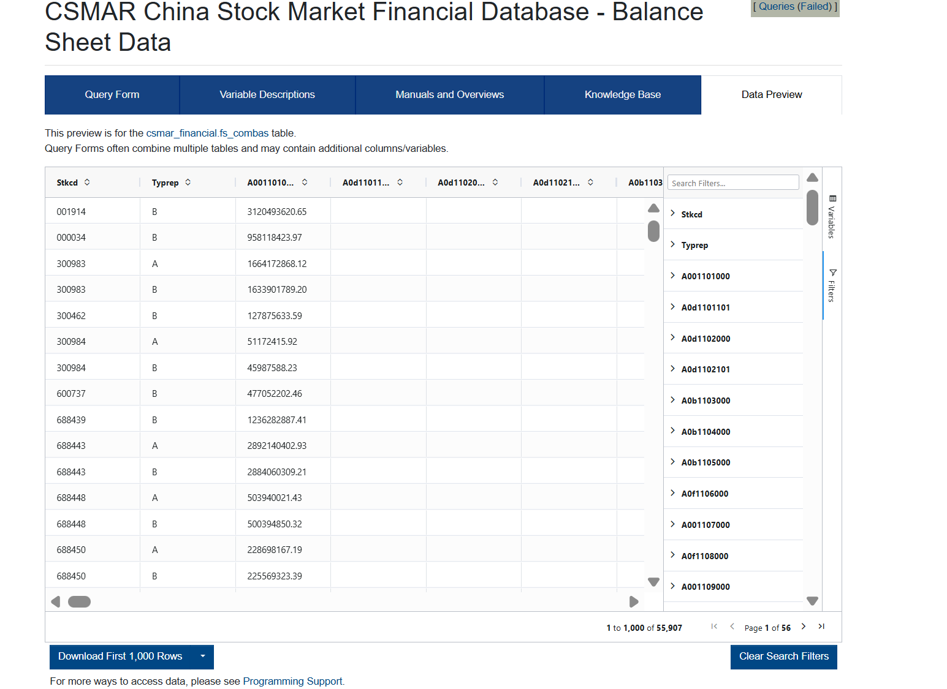
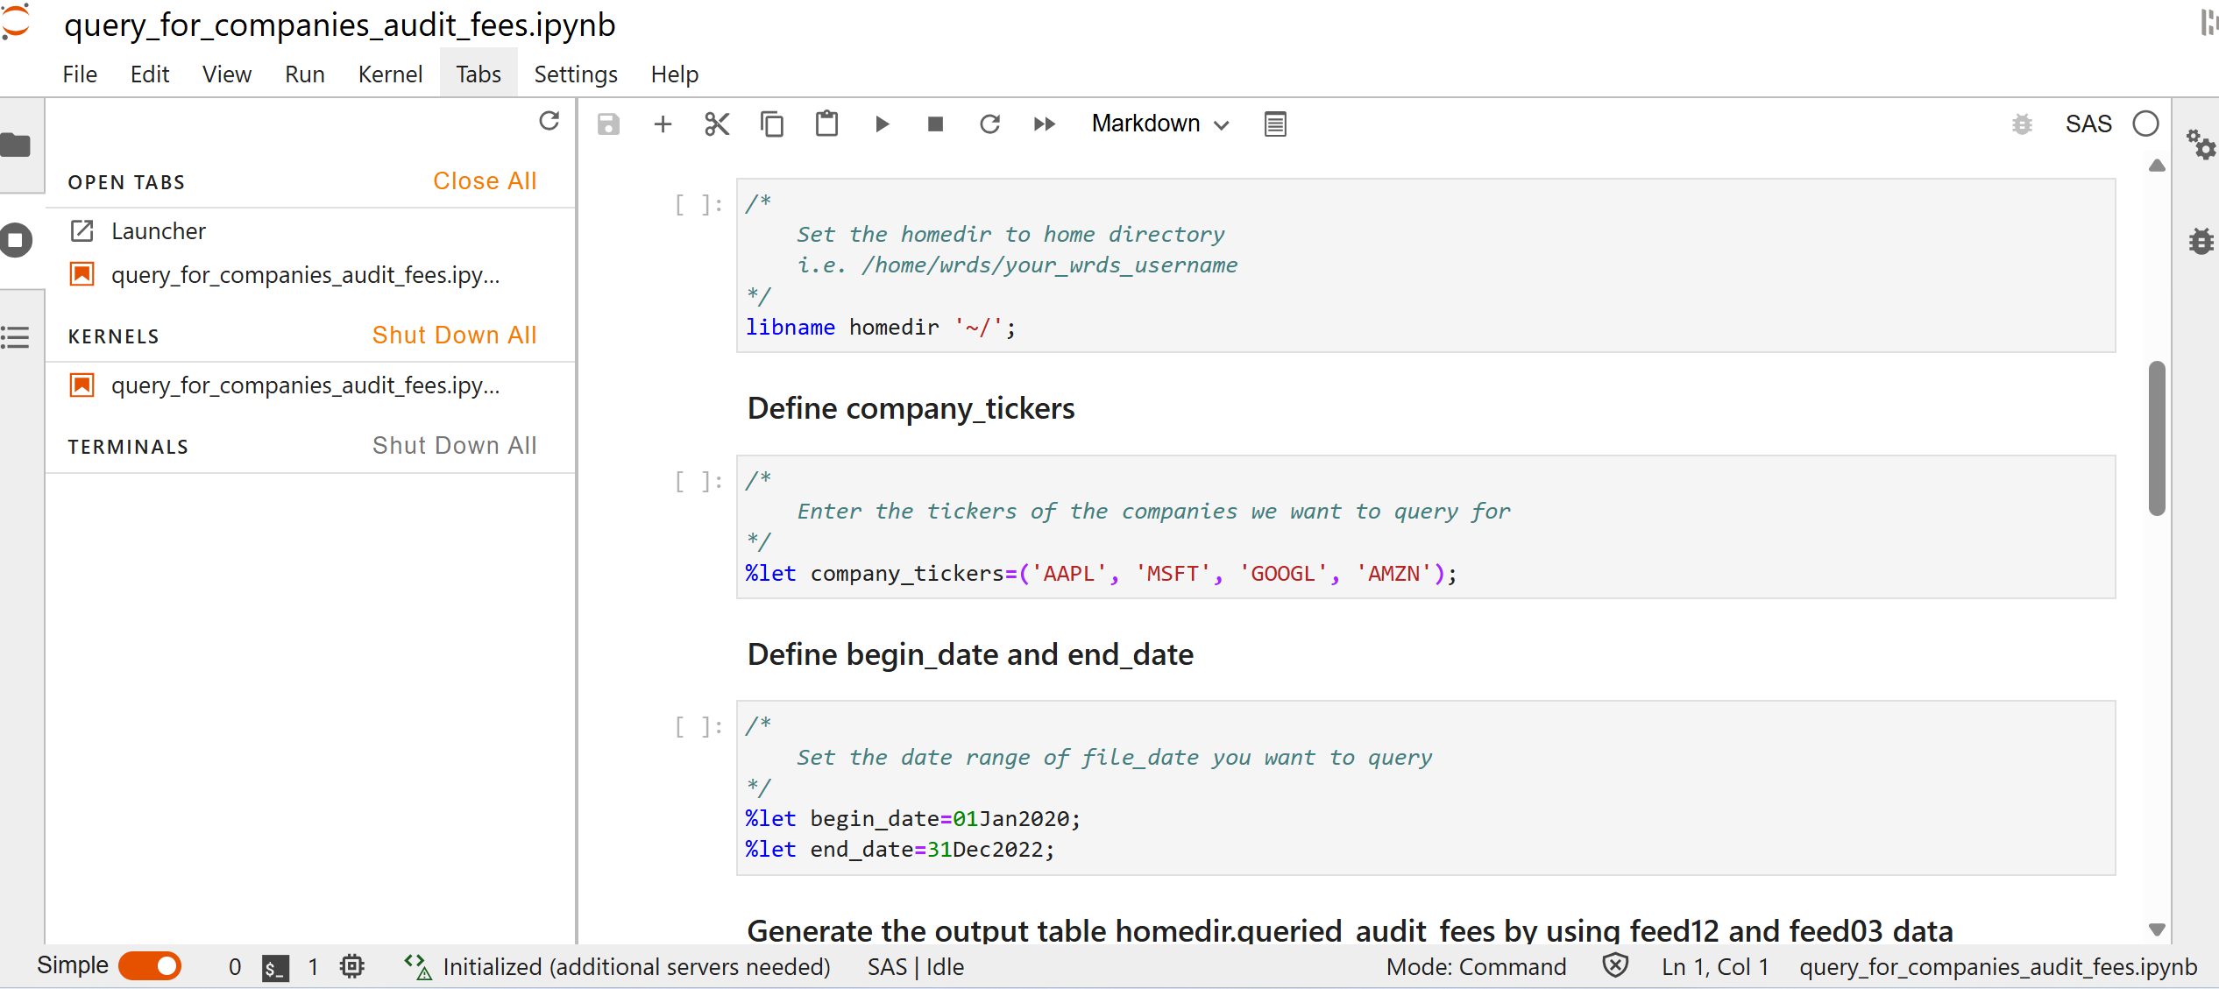
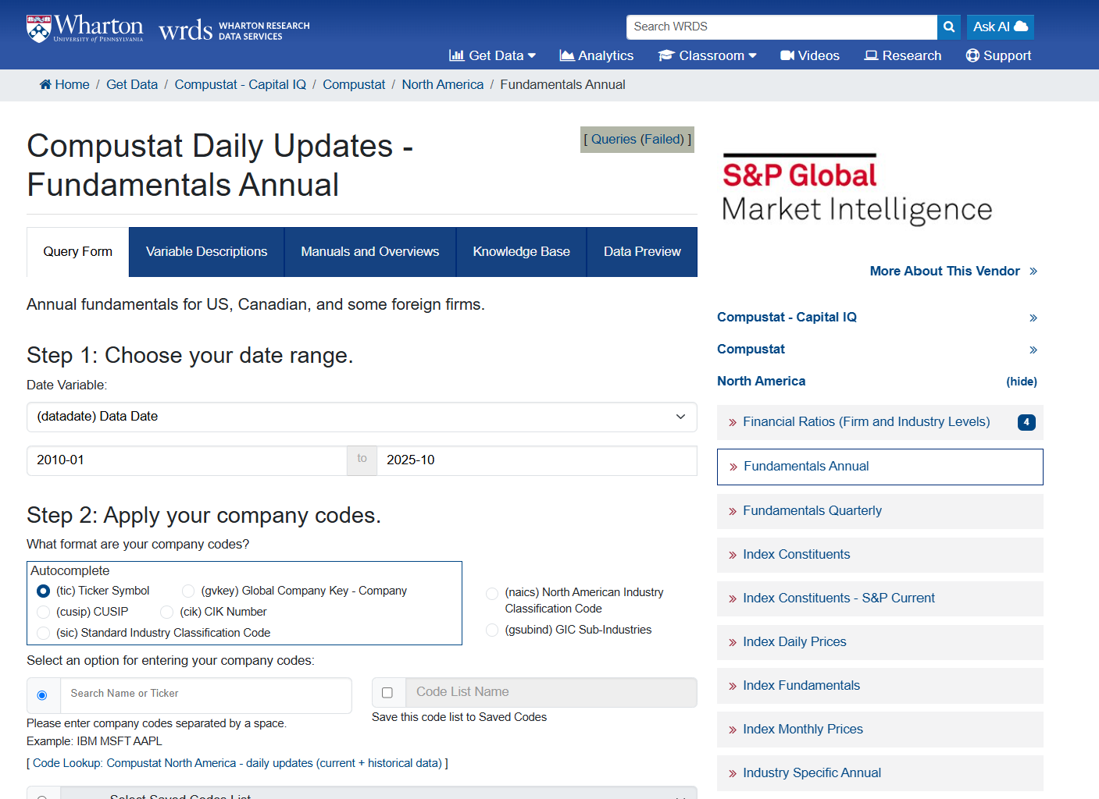
WRDS Interfaces
  Here are some examples

Slide 6

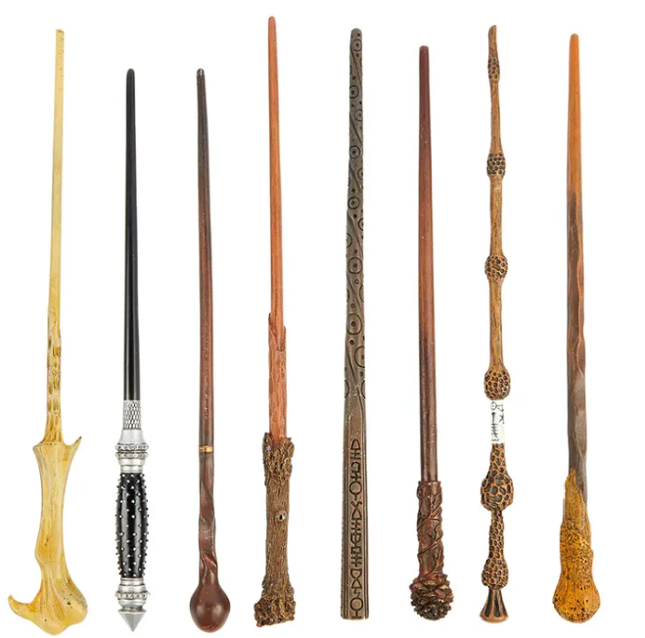

WRDS Data Team
We work with data
We work with different teams. We connect users and data vendors
We extract, transform and load (ETL) data
We create products from raw data
Notes:
We are sorcerers and witches. We have lots of tools. And SAS is one of them. ☺

Slide 7
CSMAR ETL Automation Project
  About CSMAR Data
    China Stock Market & Accounting Research
    12 CSMAR products/databases on WRDS
    The date range is from 1990 to present
    Annual update
    240 tables/datasets, 5490 variables in the 2025 update
    Update: convert SQL Server format data files (.mdf) to cleaned SAS format data files
Notes:
In every update, numbers of tables/datasets, variables keep changing.

Slide 8
CSMAR ETL Automation Project
  Pain Point and Bottleneck:
  Data cleaning of the SAS datasets
  Add variable and dataset labels
  Convert important date variables from plain numbers or chars to SAS date-format numbers
  Sort datasets, add indexes and route datasets to the right folders
  The conventional approach includes tedious and time-consuming manual work

Slide 9
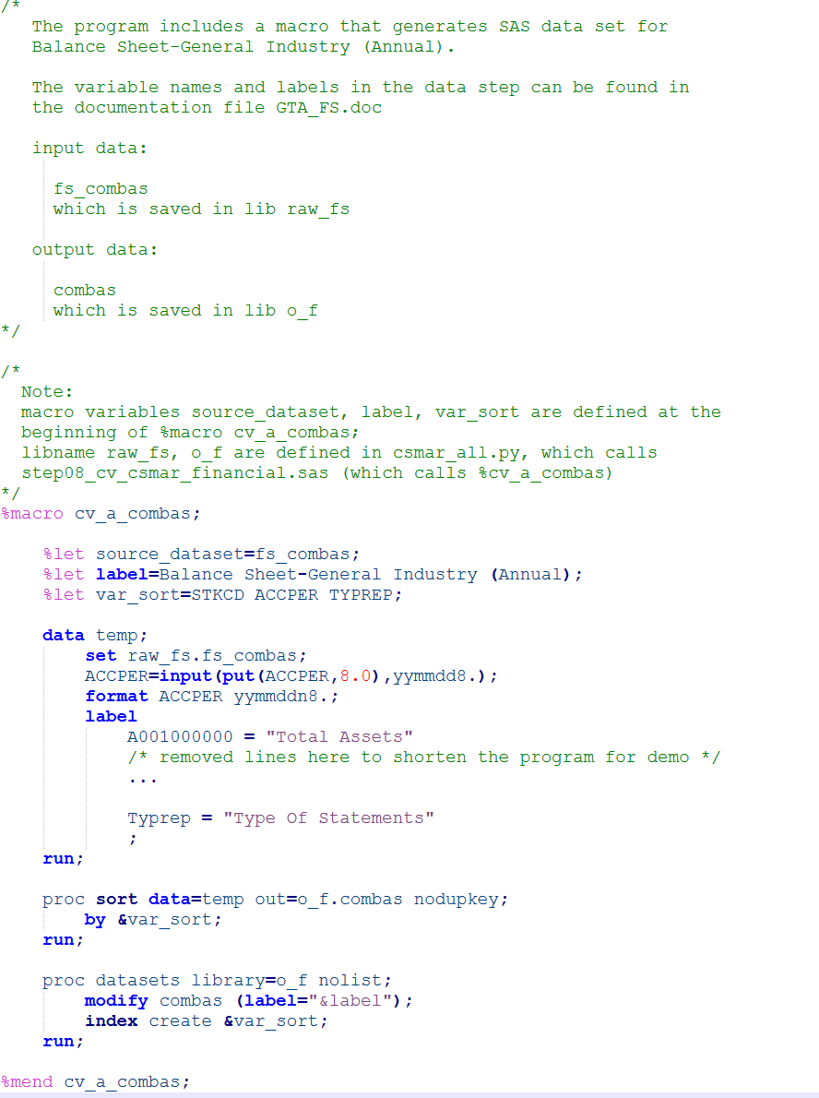
CSMAR ETL Automation Project
  A typical old SAS program
Notes:
As you can see in the code, an old SAS program only cleans one dataset.

Slide 10
CSMAR ETL Automation Project
  Conventional Approach
  Manually update hundreds of similar SAS programs to match the vendor’s variables and datasets changes.
Notes:
The manual process of cutting, pasting, and modifying code introduces errors and inefficiencies.
With more vendors, products, and rising speed expectations, we need a faster, automated way to update the data.

Slide 11
CSMAR ETL Automation Project
  Summary of the New SAS Program
  Uses the Excel-format data summary file provided by the data vendor as input
  Creates two SAS datasets (table/dataset level and variable level) from the Excel file
  Defines macro variables by using information from the two SAS datasets. Loops through the values of the macro variables and writes a SAS program for each dataset dynamically and append them into a large output SAS program
  Runs this large SAS program

Slide 12

CSMAR ETL Automation Project
  NEW SAS Program: How it looks
On: https://github.com/xyy8888/PhilaSUG2025_Halloween
Choose: sas_program_example_02_new_program.sas
Notes:
You can take out your cellphone and scan this QR code to go to the repository I created on GitHub for this presentation and choose the example new SAS program. Now let’s talk about the steps in the new program in details. (Proceed to the next page)

Slide 13
CSMAR ETL Automation Project
  NEW SAS Program: Step 1
  reads in the Excel-format data dictionary file provided by CSMAR
  to generate two data dictionary SAS datasets:
  1.1) rawsas.csmar_dd_at_table_level
  1.2) rawsas.csmar_dd_at_variable_level

Slide 14
CSMAR ETL Automation Project
  NEW SAS Program: Step 2
  Uses rawsas.csmar_dd_at_table_level and rawsas.csmar_dd_at_variable_level to dynamically generate a single SAS program, autogen_csmar_data_cleaning_program_&current_year..sas. This program sequentially appends the code required to clean each CSMAR SAS dataset*
  *the SAS datasets that were converted from SQL Server tables without any cleaning

Slide 15
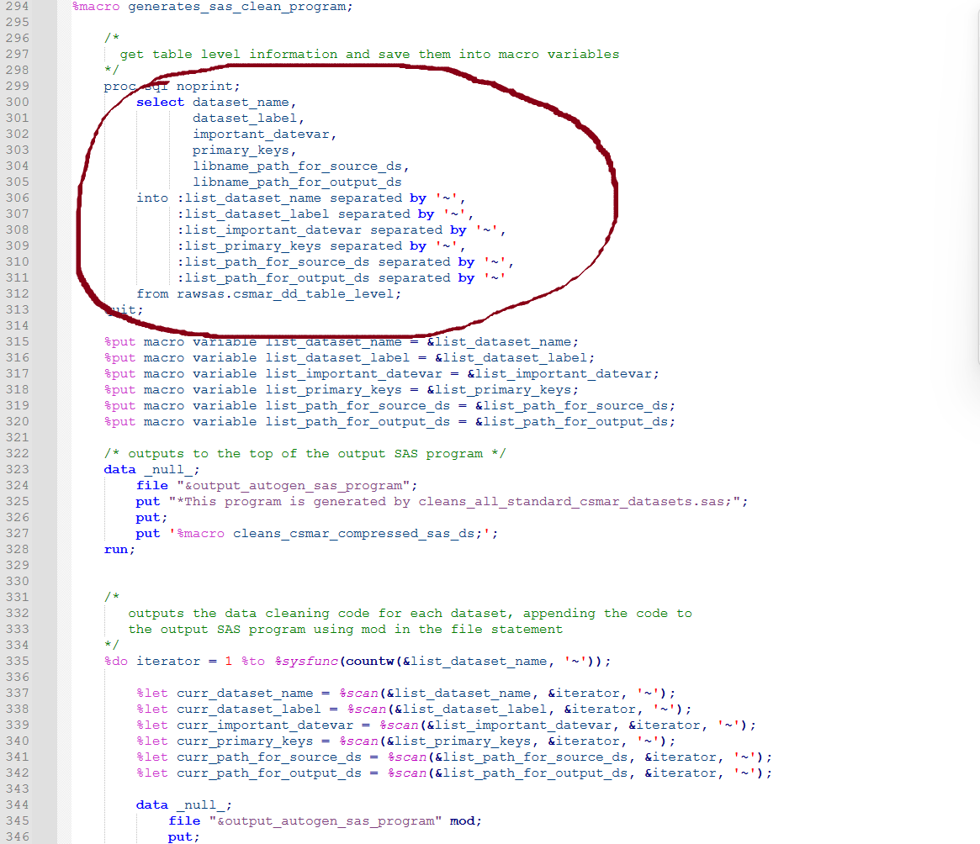
CSMAR ETL Automation Project
  Important Technical Points in Step 2
  It uses PROC SQL; SELECT INTO : to define macro variables by using information from the two SAS datasets
Notes:
It uses PROC SQL; SELECT INTO : to define macro variables by using information from the two SAS datasets

Slide 16
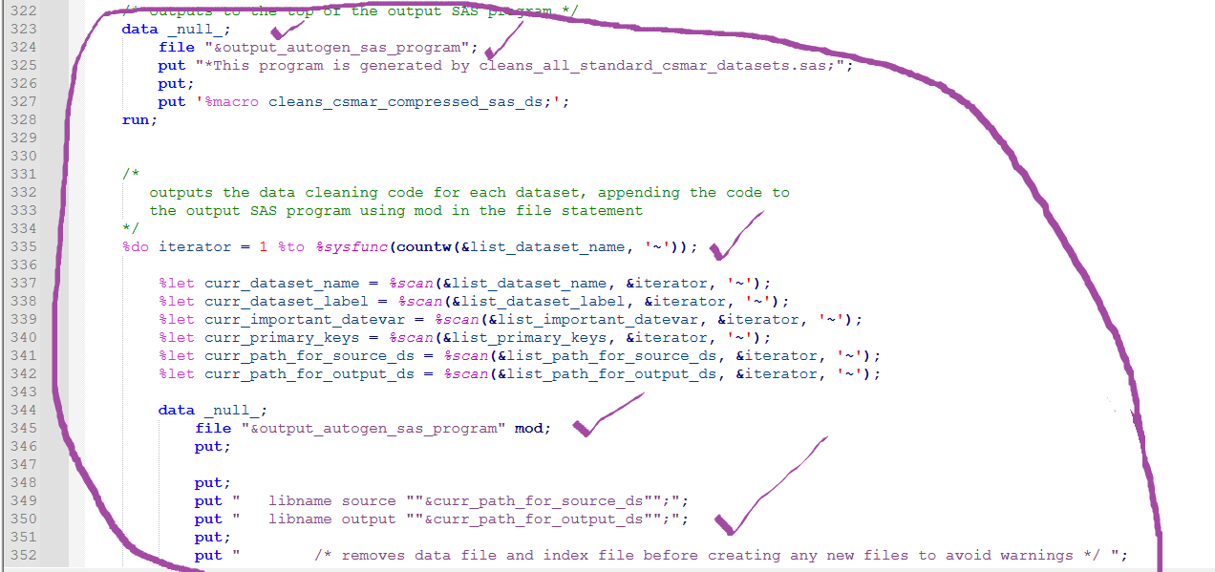
CSMAR ETL Automation Project
  Important Technical Points in Step 2
  Within a DATA _NULL_ step, it uses FILE and PUT statements to write SAS code dynamically for each dataset using the current macro variable values
Notes:
Within a DATA _NULL_ step, it uses FILE and PUT statements to write SAS code dynamically for each dataset using the current macro variable values

Slide 17
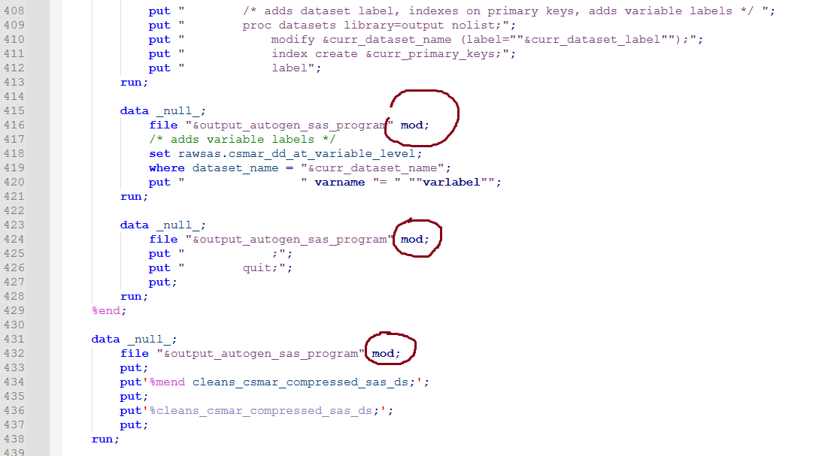
CSMAR ETL Automation Project
  Important Technical Points in Step 2
  It appends the code into a large output SAS program.
Notes:
It appends the code into a large output SAS program.
“mod” means modify, i.e. append.

Slide 18
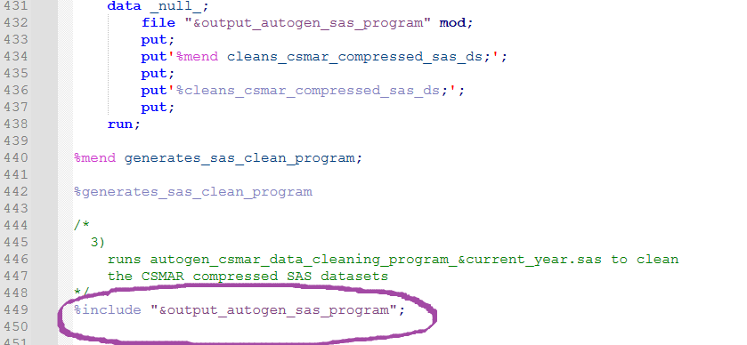
CSMAR ETL Automation Project
  NEW SAS Program: Step 3
  It uses %INCLUDE to run the large SAS program
  autogen_csmar_data_cleaning_program_&current_year.sas to clean all the CSMAR SAS datasets
Notes:
It uses %INCLUDE to run the large SAS program
autogen_csmar_data_cleaning_program_&current_year.sas to clean all the CSMAR SAS datasets

Slide 19
CSMAR ETL Automation Project
What I Like about the New SAS Program
  Readable: especially the PUT statements
  Efficient: eliminates manual coding time
  adapts to table and variable changes
  Consistent: treats datasets similarly
  Scalable: works for large databases
  Easy to test and easy to debug
  Has potential to support multiprocessing
Notes:
About “Readable”:
the code in the PUT statements are very similar to those in the old SAS program.
It’s easy to code and the code is easy to understand.
There is no need to change the new code when the data vendor makes changes to the raw data.

Slide 20
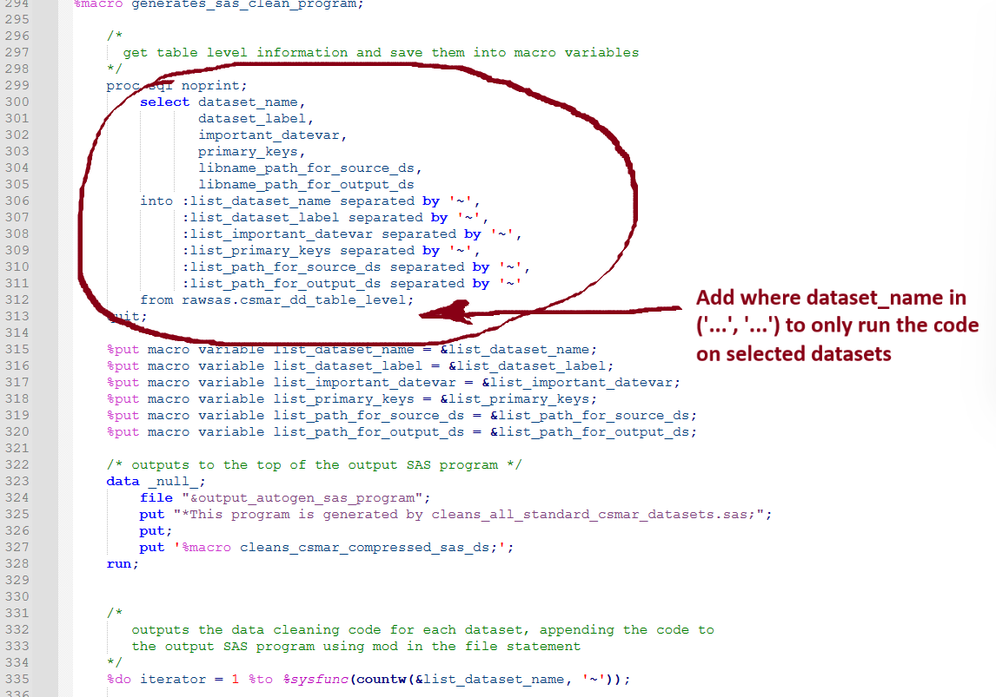
CSMAR ETL Automation Project
  About Testing and Debugging
  We can use a where statement to subset rawsas.csmar_dd_table_level to only run the program on selected tables and then check the shorter version of the output SAS program
Notes:
We can use a where statement to subset rawsas.csmar_dd_table_level to only run the program on selected tables and then check the shorter version of the output SAS program.

Slide 21
CSMAR ETL Automation Project
  Possible Future Improvement to the New Program
  Sequential Processing to Multiprocessing
  Split the input datasets and run the program on them in parallel
Notes:
Currently, we write the SAS program on the 200+ datasets one by one and run the whole program. So we are sequentially processing the data. In the future, we can split the input datasets and generate multiple SAS programs. And then, we can run the automatically generated SAS programs in parallel. In this way, we can cut the total runtime to just a fraction of what it is now.

Slide 22
FAQ
Why do we use SAS to write the output SAS program? Why not use other programming languages like Python?
Why didn’t we go automation earlier?
Notes:
Before the Q&A, I want to share two popular questions:
1.
SAS program can directly use the data from the SAS datasets. This together with the strong data analysis capability of SAS makes SAS my #1 choice for the cases where we want to use SAS datasets as the source data.
2.
Rome was not built in a day.
We went from a few manually written SAS programs to more than 150 similar SAS programs in many years. Each year, the data vendor sent us changes. We then added/deleted/modified programs. It is always a little intimidating to make significant changes until one day we have to. So, the lesson we learnt here is, be cautious about the existing convention. We need to reevaluate it constantly to see if there is a better way for the long run and invest in it.
And we were lucky that the data vendor started to send us a high-quality Excel spreadsheet that summarizes all the data.

Slide 23


Slide 24
Thanks ☺
Notes:
I would like to thank Matt Cohen, Kevin Butler for their support for the CSMAR Automation Project and my WRDS coworkers who attended my preview of this presentation for their invaluable comments and suggestions. And I would like to thank CSMAR for the data and the documentation files.
And last but not the least, everyone here.

