Slide 1



Macro to Compare ADaM Spec Derivations Against Available SDTM Data
Ingrid Shu has been a statistical programmer at Merck since July 2023. She received her bachelor's degree in statistics from University of Pittsburgh in 2023 and is currently pursuing a master’s degree in Health Data Science. She currently lives in Pennsylvania and enjoys running, hiking, and learning sign language.
Kexin Guan is a Statistical Programmer at Merck, where she has been part of the Oncology Early Development group since December 2022. She holds a Master's degree in Biostatistics and is proficient in SAS and R. Kexin is passionate about leveraging programming to enhance efficiency and compliance in pharmaceutical programming.
Jeff Xia is a Senior Director of Statistical Programming at Merck. He has over 20 years of experience working in both CRO and pharmaceutical Companies. His main interest is in application development, project management, CDISC implementation in Clinical Trials and e-Sub related processes.

Slide 2
Macro to Compare ADaM Spec Derivations Against Available SDTM Data
PhilaSUG 2025
Ingrid Shu, Kexin Guan, Jeff Xia
Merck & Co., Inc., Rahway, NJ, USA

Slide 3
Background & Motivations
ADaM Specifications plays an essential role in the statistical analyses of clinical trials
Provides the guidelines for developing ADaM datasets and their associated metadata
Covers a wide range of elements:
Variable names
Labels
Data types
Lengths
Display formats
Derivations
Programming notes

Slide 4
Background & Motivations
Programmers often use a global standard ADaM spec as a template and then adjust the derivation rules to fit specific study needs
→ susceptible to errors
Mismatches between spec derivations and SDTM values are common
Manual cross‑checking is tedious and error‑prone

Slide 5
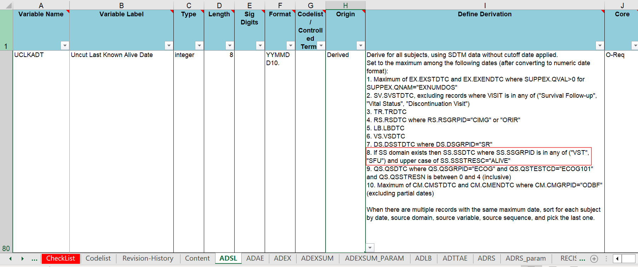
An Example of a Potential Issue
According to spec: derive UCKLADT based on SS domain where SSGRPID = “VST”
SS domain for this particular study has no records with SSGRPID = “VST” → Actual value of SSGRPID is “OVST”
If this discrepancy is neglected, the information from the OVST form will not be considered when deriving UCLKADT
Notes:
The specification for variable UCLKADT ("Uncut Last Known Alive Date") from ADSL.
Its derivation inputs information from a variety of SDTM domains including EX, SV, TR, LB
Downstream consequences: hazard ratio being derived incorrectly, efficacy outputs being inaccurate; which are all consequences we want to avoid

Slide 6
THE MACRO SOLUTION %spec_sdtm_compare
Notes:
Sas macro

Slide 7
%spec_sdtm_compare Overview
What it does:
Parses derivation rules from ADaM spec via regular expression
Checks that each spec value exists in SDTM data
Flags missing variables & value mismatches
Why it helps:
Automates end‑to‑end spec validation
Gives a dataset‑organized overview of all discrepancies

Slide 8
The Macro Inputs
input_spec | ADaM specification file pathname; can be either XLSM or XLSX format
sdtm_library | pathname of where the SDTM data is stored
output_path | pathname of where the results Excel file will be output to
output | additional string to add to output file name
Example macro call:
%spec_sdtm_compare(input_spec = %str(/path/Oncology-template-ADAM12-SDTM32.xlsm)
,sdtm_library =%str(/path/datasdtm)
,output_path = %str(/path/output)
,output = all);
Notes:
Sdtm_library is lptss at Merck

Slide 9
Macro Program Flow

Slide 10
Step I – Read In SDTM data & ADaM spec
Assign librefs, loop through “AD–” sheets, convert to SAS datasets
Step II – Extract Derivation Expressions
Regex used to catch the following patterns:
1. (SUPP)XX.YYYY = "aaa"
2. (SUPP)XX.YYYY = "aaa" or "bbb"
3. (SUPP)XX.YYYY is in any of ("aaa","bbb")
4. (SUPP)XX.YYYY in ("aaa", "bbb")
5. (SUPP)XX.YYYY equals any of ("aaa", "bbb")
Store matches in a spec‐expressions variable
Flag where:
Spec domain or var not in SDTM (DOMAIN OR VARIABLE DOES NOT EXIST)
XX: SDTM domain | YYYY: SDTM variable name | aaa, bbb: SDTM variable values

Slide 11
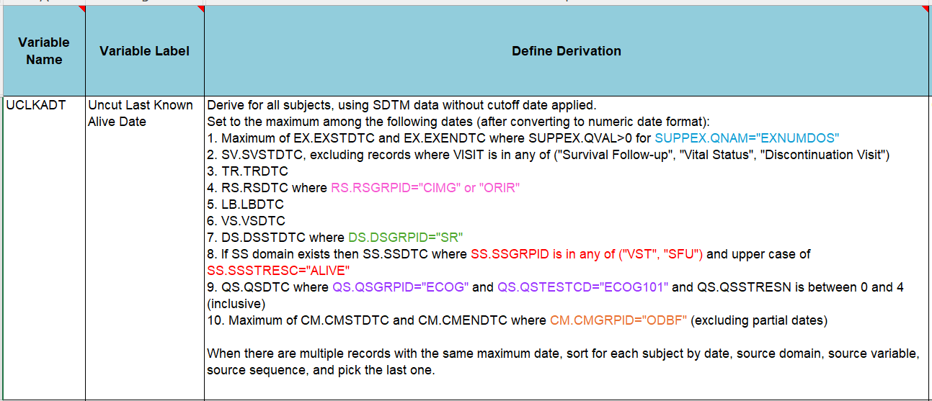
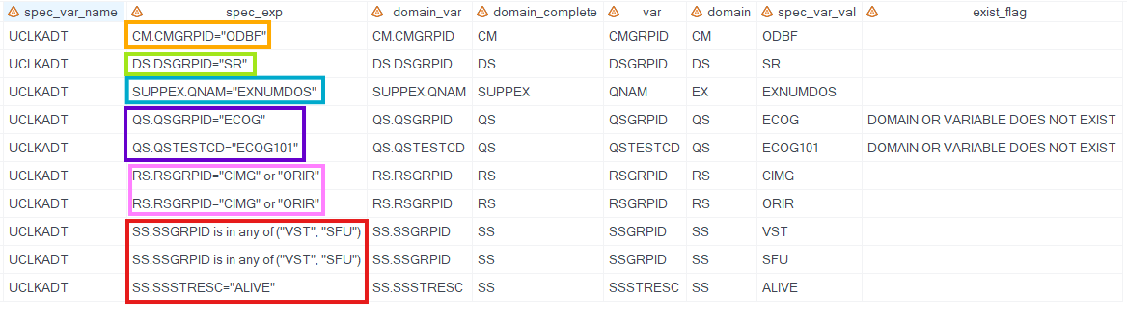
Notes:
Going back to our previous example of the derivation for Uncut Last Known Alive Date,
Here are the expressions that would be extracted from the Define Derivation column
Example with exist_flag: either QS domain does not exist in SDTM data, or QSGRPID and QSTESTCD variables do not exist in the QS domain

Slide 12


Step III – Compare Values
Loop through SDTM data, one domain & variable at a time
Concatenate unique values → sdtm_values
Flag where:
Spec value not in SDTM (SPEC VALUE NOT FOUND IN SDTM)
Step IV – Export Results to Excel
One worksheet per each ADaM dataset with ≥1 derived expression
Ready‑to‑share mismatch report
Notes:
Third step is to compare the sdtm values from the Define Derivation columns against the available sdtm data values
The way we do this is we first create a variable called sdtm_values that is comprised of a concatenation of all the sdtm data values for a specific SDTM variable
For example: CMGRPID from the CM domain yields the values CM and ODB which are concatenated and stored in the sdtm_values variable

Slide 13
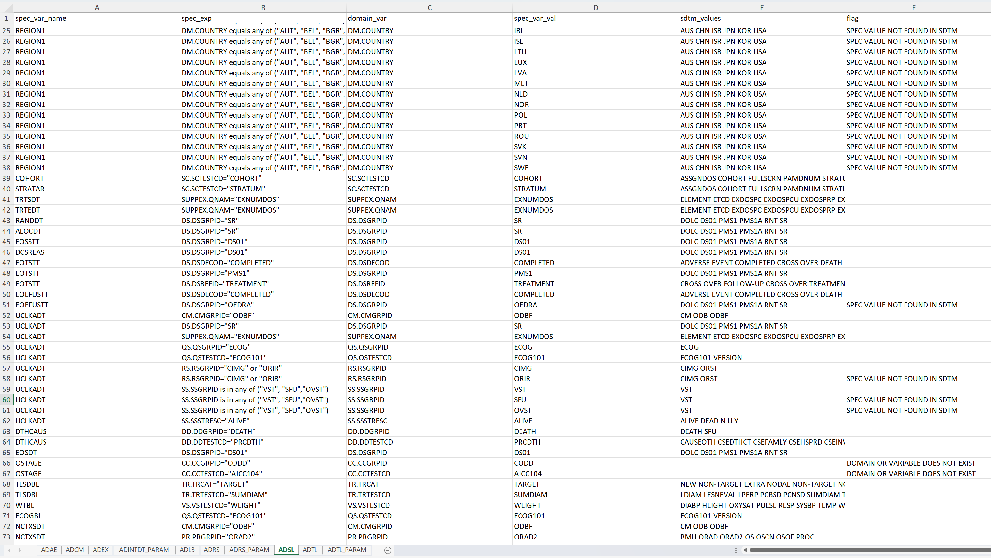
The expression extracted from derivation definition
Flag for whether the variable derivation should be further inspected
The SDTM domain and variable from the expression
The spec’s SDTM variable value
The available SDTM values
The ADaM variable
Example:
“OEDRA” is not a valid value in SDTM DS.DSGRPID data
Derivation definition for ADSL.EOEFUSTT should be updated
Notes:
Looking at the results for ADSL

Slide 14
Conclusion & Next Steps
Key Takeaways:
%spec_sdtm_compare is an easy but powerful tool
Automates cross‑checking, saving hours of manual QC
Highlights only the variables with mismatches; good for targeted review
Does not share overlapping utility with existing resources in eSub checks and P21
Limitations:
Balancing false positives vs. coverage
Sensitive to spec‑file formatting changes (sheet names, column headers)
Future Work:
Expand regex library to catch more derivation styles
Testing on ADaM specs from more therapeutic areas
Notes:
Useful for validation and quality checks in the analysis and reporting process of completing deliverables
Testing on more TAs since it has mostly been tested on ADaM specs from early-stage oncology studies

Slide 15
THANK YOU

Slide 16
Acknowledgements & Contact Information
We would like to thank our managers, team members, and the Merck BARDS SP Rising Professionals Club for support and feedback in the creation of this tool and paper.
Your comments and questions are valued and encouraged. Our contact information:
Ingrid Shu
Merck & Co., Inc., Rahway, NJ, USA ingrid.shu@merck.com
Kexin Guan
Merck & Co., Inc., Rahway, NJ, USA
kexin.guan@merck.com
Jeff Xia
Merck & Co., Inc., Rahway, NJ, USA
jeff.xia@merck.com

