Slide 1
Five Little Known, But Highly Valuable, PROC SQL Programming Techniques
a presentation by
Kirk Paul Lafler

Slide 2
Copyright © 1992-2016 by
Kirk Paul Lafler and Software Intelligence Corporation.
All rights reserved.
SAS is the registered trademark of SAS Institute Inc., Cary, NC,
USA.
All other company and product names mentioned are used for
identification purposes only and may be trademarks of their
respective owners.

Slide 3
Presentation Objectives
Summarizing
Data
Down Rows
and Across Columns
Identifying
FIRST., LAST. and Between Rows within BY-Groups
Creating
and Searching Value-list Macro Variables
Defining Integrity Rules to Safeguard a Table from “Unsafe” Data
Examining the SQL Optimizer’s Execution Plan

Slide 4
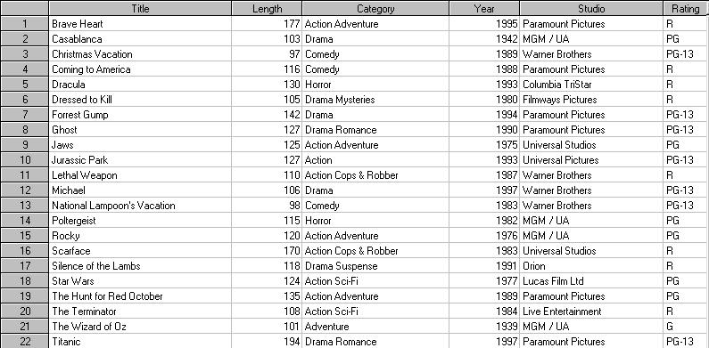
Tables Used in Examples
Movies
Actors

Slide 5
1
Summarizing Data
Down Rows
and
Across Columns

Slide 6
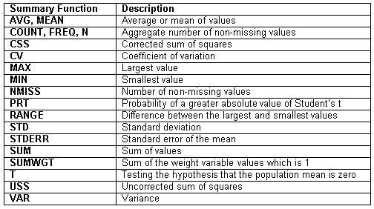
Summary Functions Available to SQL

Slide 7
Summarizing Down Rows with AVG
The SQL procedure can be used to produce a single aggregate value by summarizing data down rows. Using the AVG function produces the average movie length for all “Comedy” movies.
PROC SQL;
SELECT AVG(LENGTH) AS Avg_Movie_Length
FROM MOVIES
WHERE UPCASE(CATEGORY) IN (“COMEDY”);
QUIT;

Slide 8
Summarizing Across Columns
SQL can be used to summarize data across columns. Using the MAX function, the longest movie length is determined and then the difference between the maximum and current movie length.
PROC SQL;
SELECT MAX(LENGTH) AS Longest_Movie,
MAX(LENGTH) – LENGTH
AS Difference
FROM MOVIES;
QUIT;
Longest_Movie Difference
194 17
194 91
194 97
194 78
194 64
… …
194 76
194 70
194 59
194 86
194 93
194 0

Slide 9
Using the CALCULATED Keyword
To avoid having to compute the MAX function a second time, the CALCULATED keyword is used to determine the difference between the maximum and current movie length.
PROC SQL;
SELECT MAX(LENGTH) AS Longest_Movie,
CALCULATED Longest_Movie – LENGTH
AS Difference
FROM MOVIES;
QUIT;
Longest_Movie Difference
194 17
194 91
194 97
194 78
194 64
… …
194 76
194 70
194 59
194 86
194 93
194 0

Slide 10
2
Identifying
FIRST., LAST., and Between Rows within BY-Groups

Slide 11
FIRST., LAST., and Between Processing
Performing by-group processing to identify FIRST., LAST., and BETWEEN observations in a DATA step is a popular programming technique with SAS users. The SQL procedure can emulate this stalwart DATA step programming technique using subqueries.

Slide 12
FIRST. BY-group Code Emulation
/*****************************************************/
/** ROUTINE.....: FIRST-BY-GROUP-ROWS **/
/** PURPOSE.....: Identify the first (min) row in **/ /** each by-group using a subquery. **/
/*****************************************************/
proc sql;
create table first_bygroup_rows as
select rating,
title,
'FirstRow' as ByGroup
from movies M1
where title =
(select min(title)
from movies M2
where M1.rating = M2.rating)
order by rating, title;

Slide 13
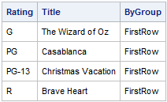
FIRST. BY-group Code Results

Slide 14
LAST. BY-group Code Emulation
/*****************************************************/
/** ROUTINE.....: LAST-BY-GROUP-ROWS **/
/** PURPOSE.....: Identify the last (max) row in **/ /** each by-group using a subquery. **/
/*****************************************************/
create table last_bygroup_rows as
select rating,
title,
'LastRow' as ByGroup
from movies M1
where title =
(select max(title)
from movies M2
where M1.rating = M2.rating)
order by rating, title;

Slide 15
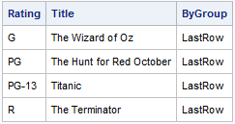
LAST. BY-group Code Results

Slide 16
Between BY-group Code Emulation
/***********************************************************/
/** ROUTINE.....: BETWEEN-BY-GROUP-ROWS **/
/** PURPOSE.....: Derive the between rows within each **/
/** By-group. **/
/***********************************************************/
create table between_bygroup_rows as
select rating,
title,
min(title) as Min_Title,
max(title) as Max_Title,
'BetweenRow' as ByGroup
from movies
group by rating
having CALCULATED min_Title NOT =
CALCULATED max_Title AND
CALCULATED min_Title NOT =
Title AND
CALCULATED max_Title NOT = Title
order by rating, title;

Slide 17
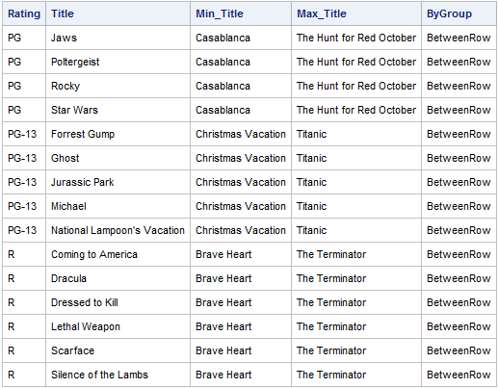
Between BY-group Code Results

Slide 18
Append FIRST., LAST. and Between
/***********************************************************/
/** ROUTINE.....: CONCATENATE-FIRST-BETWEEN-LAST **/
/** PURPOSE.....: Concatenate the results from the first **/
/** (min) row, between rows, and last (max) **/
/** row within each by-group, and print. **/
/***********************************************************/
create table first_between_last_rows as
select rating,
title,
bygroup
from first_bygroup_rows
UNION ALL
select rating,
title,
bygroup
from between_bygroup_rows
UNION ALL
select rating,
title,
bygroup
from last_bygroup_rows;

Slide 19
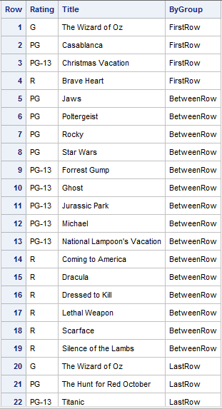
FIRST., LAST., and Between Results

Slide 20
3
Creating and
Searching
Value-list
Macro Variables

Slide 21
Creating Value-list Macro Variables
Asterisk-delimited, or some other delimited, values can be created in a macro variable by concatenating values of a single column into one macro variable.
PROC SQL NOPRINT ;
SELECT title
INTO :mtitle SEPARATED BY '* '
FROM movies
WHERE UPCASE(rating)='PG’ ;
QUIT ;
%PUT &mtitle ;
Casablanca* Jaws* Poltergeist* Rocky* Star Wars* The Hunt for Red October

Slide 22
Creating Value-list Macro Variables
A list of values can be created by concatenating one or more values from a single column into one macro variable using the SQL procedure.
PROC SQL NOPRINT ;
SELECT title
INTO :mtitle SEPARATED BY ‘~ '
FROM movies
WHERE UPCASE(rating)='PG’ ;
QUIT ;
%PUT &mtitle ;
Casablanca~ Jaws~ Poltergeist~ Rocky~ Star Wars~ The Hunt for Red October

Slide 23
Scanning Value-list Macro Variables
Selected values can be searched within a macro variable using a %SCAN function and the value used in a WHERE-clause.
options symbolgen ;
proc sql noprint ;
select title into :mtitle separated by ‘~ '
from movies where rating = 'PG’ ;
%let scanvar = %scan(&mtitle,3,~) ;
select title, rating
from movies
where title = "&scanvar” ;
quit ;
SYMBOLGEN: Macro variable SCANVAR resolves to Poltergeist

Slide 24
4
Defining Integrity
Rules to Safeguard a Table from
“Unsafe” Data

Slide 25
Methods of Building Integrity
Data integrity problems such as missing values, duplicate values, invalid data values, and lost linkages among rows of data can affect user confidence in a database environment. Database objectives include establishing rules that will safeguard and protect your data.
Methods of Building Integrity into Data:
Application programs – Older Approach
Database environment – Preferred Approach

Slide 26
Column / Table Integrity Constraints
Data integrity is maintained by assigning column and table constraints. Modifications made through update and delete operations can have referential integrity constraints built into the database environment.
Column and Table Constraints:
NOT NULL
UNIQUE
CHECK

Slide 27
NOT NULL Constraint
To prevent null values from appearing in any row of a table for a specified column, a NOT NULL constraint is coded.
PROC SQL;
CREATE TABLE work.RENTAL_INFO
(TITLE CHAR(30) NOT NULL,
RENTAL_AMT NUM FORMAT=DOLLAR6.2);
QUIT;

Slide 28
UNIQUE Constraint
Using the UNIQUE constraint prevents rows containing duplicate values for a specified column to be added to a table.
PROC SQL;
CREATE TABLE work.RENTAL_INFO
(TITLE CHAR(30) UNIQUE,
RENTAL_AMT NUM FORMAT=DOLLAR6.2);
QUIT;

Slide 29
Building a Validation CHECK
A CHECK constraint can be constructed to establish specific rules that the column must adhere to.
PROC SQL;
ALTER TABLE MOVIES
ADD CONSTRAINT CHECK_RATING
CHECK (RATING IN (‘G’,‘PG’,‘PG-13’,‘R’));
QUIT;

Slide 30
Building a Validation CHECK
A CHECK constraint can be modified to establish specific rules that the column must adhere to.
PROC SQL;
ALTER TABLE MOVIES
ADD CONSTRAINT CHECK_RATING
CHECK (RATING IN (‘G’,‘PG’,‘PG-13’,‘PG-17’,‘R’));
QUIT;

Slide 31
5
Examining
the SQL
Optimizer’s
Execution Plan

Slide 32
The SQL Optimizer’s Execution Plan
A _METHOD option can be specified on the PROC SQL statement to display the hierarchy of query processing (or execution plan) that takes place. Results are automatically displayed on the Log.

Slide 33
Codes and Description
A _METHOD option specified with the PROC SQL statement displays the hierarchy of processing on the Log.
Code Description
sqxcrta Create table as Select
sqxslct Select
sqxjsl Step loop join (Cartesian)
sqxjm Merge join
sqxjndx Index join
sqxjhsh Hash join
sqxsort Sort
sqxsrc Source rows from table
sqxfil Filter rows
sqxsumg Summary statistics with GROUP BY
sqxsumn Summary statistics with no GROUP BY

Slide 34
Syntax for _METHOD
PROC SQL _METHOD;
SELECT M.TITLE, RATING, ACTOR_LEADING
FROM MOVIES M, ACTORS A
WHERE M.TITLE = A.TITLE;
QUIT;
SAS Log Results
NOTE: SQL execution methods chosen are:
sqxslct
sqxjhsh
sqxsrc( MOVIES )
sqxsrc( ACTORS )

Slide 35
Turning on Messages
By specifying the OPTIONS MSGLEVEL=I; system option, helpful notes describing index usage, sort utilities, and merge processing are displayed on the SAS Log.

Slide 36
Syntax for MSGLEVEL=I
OPTIONS MSGLEVEL=I;
PROC SQL;
SELECT M.TITLE, RATING, ACTOR_LEADING
FROM MOVIES M, ACTORS A
WHERE M.TITLE = A.TITLE AND
RATING=‘PG’;
QUIT;

Slide 37
SAS Log Results for MSGLEVEL=I
OPTIONS MSGLEVEL=I;
PROC SQL;
SELECT M.TITLE, RATING, LENGTH,
ACTOR_LEADING
FROM MOVIES M,
ACTORS A
WHERE M.TITLE = A.TITLE AND
RATING = 'PG';
INFO: Index Rating selected for WHERE clause
optimization.
QUIT;

Slide 38
In Conclusion
Summarizing
Data
Down Rows
and Across Columns
Identifying
FIRST., LAST. and Between Rows within BY-Groups
Creating
and Searching Value-list Macro Variables
Defining Integrity Rules to Safeguard a Table from “Unsafe” Data
Examining the SQL Optimizer’s Execution Plan

Slide 39
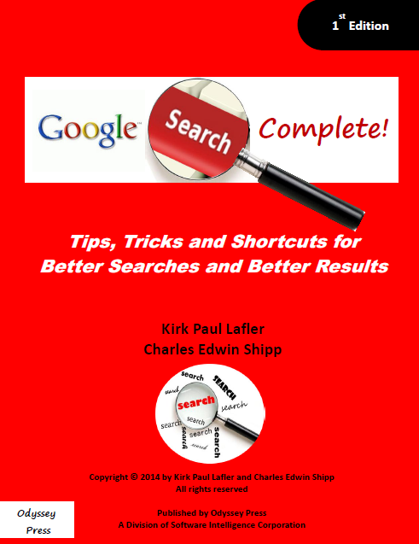
Search like a Pro!
Filled with
Tips, Tricks and
Shortcuts
for Better Searches
and Better Results
Available on Amazon.com!
Coming Winter 2004!

Slide 40
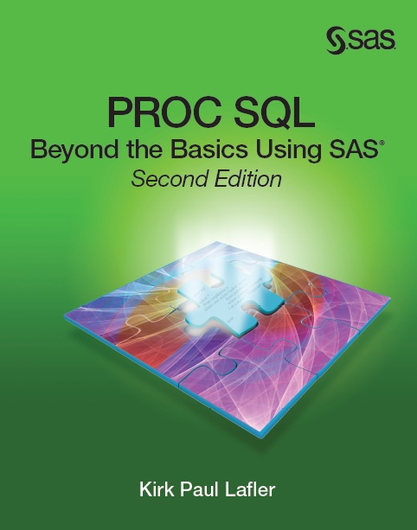
An SQL Book
with “under the
hood” details,
explanations and
lots of examples
Available from SAS Press at www.sas.com!
Coming Winter 2004!

Slide 41
Thank you for attending!
a presentation by
Kirk Paul Lafler
KirkLafler@cs.com
@sasNerd
Questions?

