Slide 1
Application of SAS®! Enterprise Miner™ in Credit Risk Analytics
Minakshi Srivastava, VP, GRM
PhilaSUG Philadelphia Area SAS Users Group 12 March 2015

Slide 2
Table of Contents
Credit Risk Analytics Overview
Journey from DATA to DECISIONS
Exploratory Data Analysis
Develop Quantitative Tools
Validate and Compare
Best Strategy Evaluation
SAS® Enterprise Miner™ – additional benefits
Challenges of Credit Risk Industry
Questions
References

Slide 3
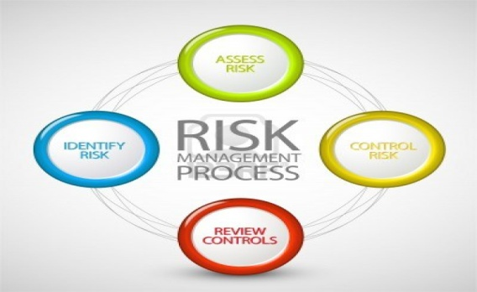
Credit Risk Analysis Overview
Credit Risk Analysis (CRA) is integral to every step in the credit lifecycle process, from prospect and customer segmentation, through origination scorecards, to the design and execution of account management and collection strategies, whether for mortgages, personal loans and lines of credit, credit cards, educational loans, auto loans, and other consumer finance vehicles.
CRA is about identifying and mitigating risk associated with financing credit product to customers. Risk team quantify risk, monitor and report risk of prospect or customer by development of risk monitoring tool, scorecard and models.
CRA guides us in taking decision on customer’s associated risk for pricing as well credit exposure decision associated with it

Slide 4
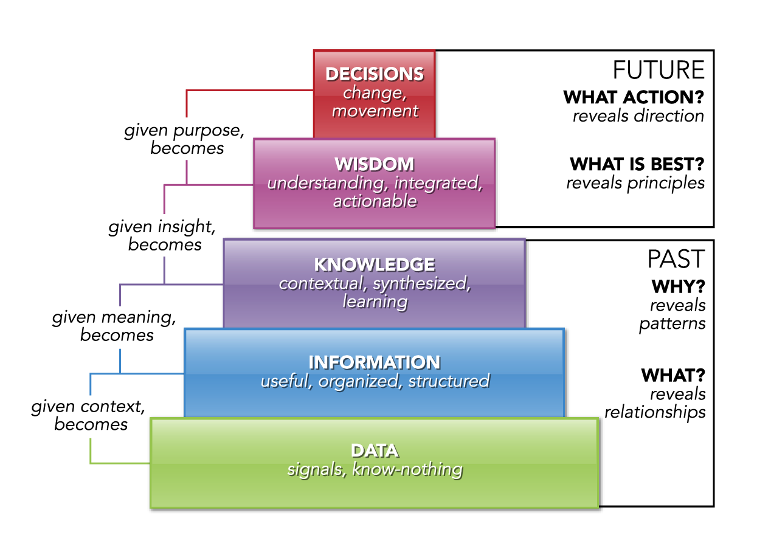
Journey from DATA to DECISION
In Credit Risk Analysis,
Team explore credit bureau data to understand and gather information about customers [Exploratory Data Analysis]
Analyze raw data to synthesize the knowledge and develop quantitative risk tools [Develop Quantitative Tools]
Validate best tool by comparing results in different time and scenarios. [Validate & Compare ]
Integrate tool into strategy for credit decisions by evaluate best strategy
[Best Strategy Evaluation]
Credit Industry heavily relies on analyzing standard credit scoring and customer provided information for credit decisions.

Slide 5
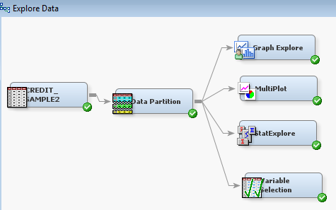
Exploratory Data Analysis (EDA)
SAS® Enterprise Miner™ is the SAS solution for data mining.
In EDA phase, risk team gathers information to get familiar with structure of data and identify initial drivers of risk. SAS® Enterprise Miner™ provides several data exploration nodes
Graph Explore node : explore data graphically to uncover patterns and trends.
Stat-Explore node: generates summary statistics and can examine variable distributions and statistics. It contributes to the initial analysis before getting deep into causation analysis.
Multi-Plot node: explore data graphically to observe data distributions and to examine relationships among the variables [i.e. By Bar graph or scatter plot].
Variable Selection: identifies initial input variables useful for predicting the target.
Note: These nodes eliminate the need to write many lines of code in PC SAS to accomplish the same results.

Slide 6
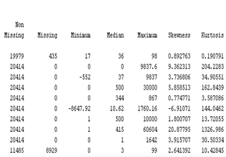
Exploratory Data Analysis – contd..
Sample Bureau Data*
Let’s analyze a sample bureau data with people demographics, payment history, length of credit, type of delinquency… etc where target** is STATUS = ‘OK’ or ‘Bad Debt’. We started exploring data by generating descriptive statistics, bar charts, scatter plots for variables as well as how target is related to other variables.
* Data is for illustrative purposes only ** Target is term used for response variable.

Slide 7
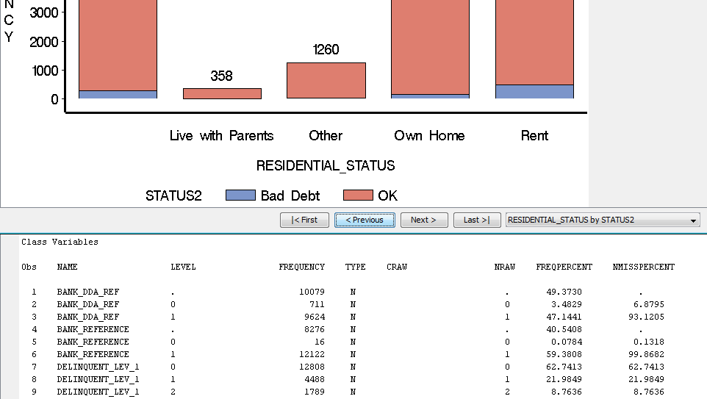
Exploratory Data Analysis – contd..
In the exploration nodes of Enterprise Miner™, visualization tools are useful in graphically representing the distributions of target vs. other variables.
* Data is for illustrative purposes only.

Slide 8
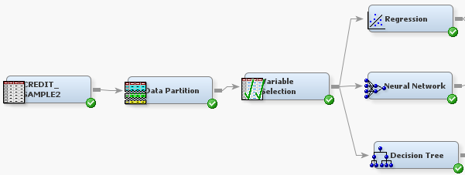
Develop Quantitative Tools
In developing quantitative tools, SAS® Enterprise Miner™ provides us numerous tools & techniques to identify top predictors .
Selection of final variables can be done through different approaches [i.e. Variable Selection, CHAID Analysis or Regression selection procedure stepwise, forward or backward].
Variable Clustering is useful in identifying variables from groups of highly correlated variables.
In the Risk Industry, quantitative tools are used in developing predictive models or scorecard or strategies.

Slide 9
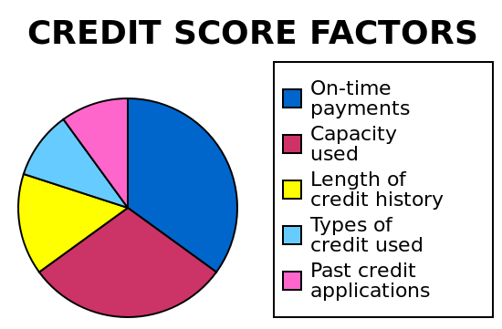
Develop Quantitative Tools contd..
The traditional form of a credit scoring model is a scorecard.
In Credit Risk Analysis, scorecard plays a key role in decision making.
Team uses different types of credit information to calculate the FICO score for the general population.

Slide 10
Develop Quantitative Tools contd..
SAS® Enterprise Miner™ development of scorecard takes following steps
Careful selection of best attributes with high information values
Binning of variables and then grouping bins variables [Interactive grouping node]
Modeling of approved credit accounts (‘Accepts’) [Scorecard node]
Building scorecard on accepts as well as inference performance of “rejects” (reject Inference node).

Slide 11
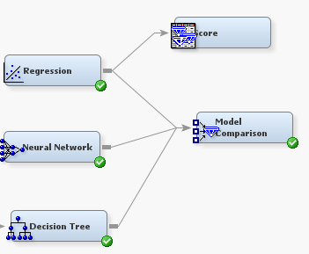
Validate & Compare
With SAS® Enterprise Miner™ , it is possible to create, validate and compare a variety of model types such as regression, scorecards, decision trees or neural networks. When we evaluate which model type is best suited for achieving our goals, we consider criteria such as
Parsimony (complexity)
Integration efficiency
Accuracy
The Score node functionality if Enterprise Miner™ facilitates scoring. It also generates SAS codes for outside validation.

Slide 12
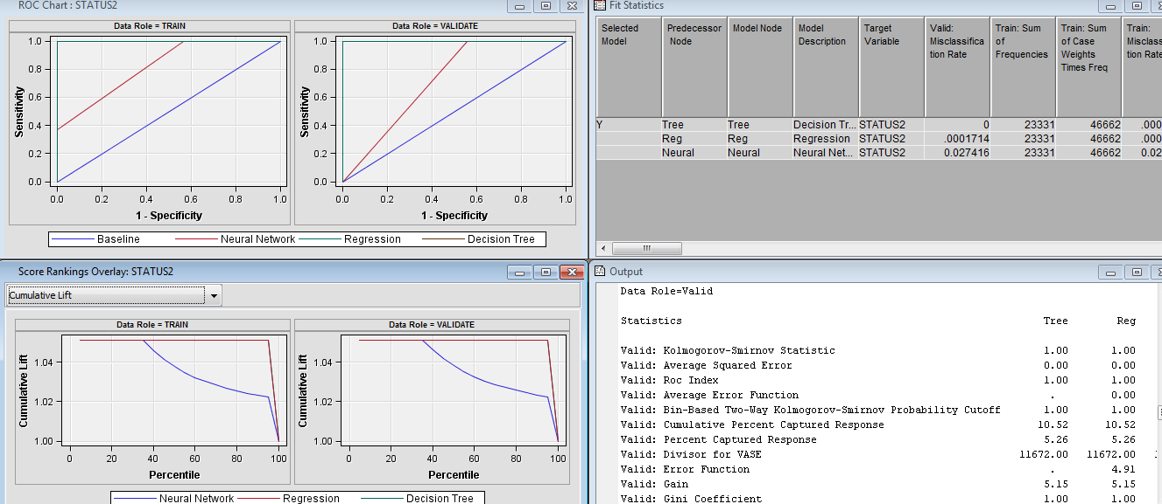
Validate & Compare contd..
Model Comparison output provides model statistics to compare and assist in decision making process.

Slide 13
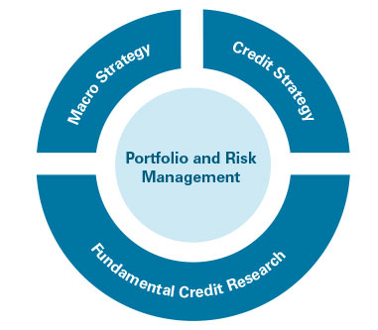
Best Strategy Evaluation
In the final step of Credit Risk Analysis:
The Risk team compares and evaluates newly developed strategies/models with existing strategies.
Validate strategies in different scenarios
SAS ® Enterprise Miner™ offers number of benefits in best strategy evaluation

Slide 14
SAS® Enterprise Miner™ – additional features
SAS® Enterprise Miner™ is the SAS solution for data mining.
Easy handling of huge amount of data, no sampling required
Several nodes for customization and exploration of raw data for faster data analysis
Variety of model types such as scorecards, regression, decision trees or neural networks
Testing new ideas and experimenting with new modeling approaches
Specialize nodes to meet industry specific need and standard regulation
Provides required documents and graphs for governance review
Easy graphical representation of complex quantitative analysis for senior leaders
Scoring code in many programming languages for easy and fast technology implementation

Slide 15
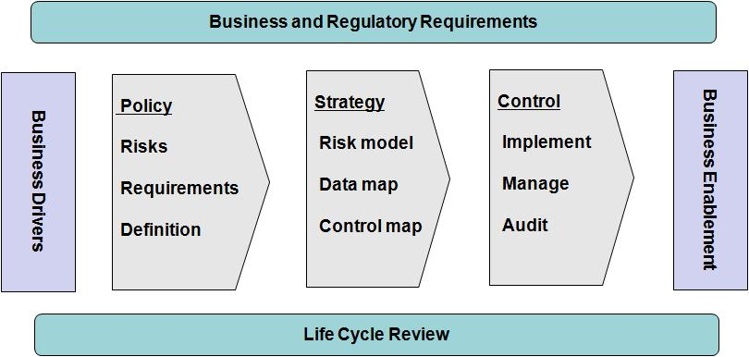
Challenge of Credit Risk Industry
Effective management of risk throughout the credit life cycle allows institutions to optimize their capital investments, reserve for future loss, (baseline and expected), and maximize shareholder value.
Its a dynamic and continually evolving industry; it’s sensitive to the macroeconomic environment, government regulation, a consumer behavior changes and risk appetite of each lender. Credit Analytics plays a critical role in adapting to these ever changing conditions while also providing the means to gain a competitive advantage in the industry.

Slide 16
Questions & further reference
Minakshi Srivastava, minakshi.srivastava@bankofamerica.com
1. Getting Started with SAS Enterprise Miner™7.1
http://support.sas.com/documentation/cdl/en/emgsj/64144/PDF/default/emgsj.pdf
2. Predictive Modeling With SAS Enterprise Miner: Practical Solutions for Business Applications by Kattamuri S. Sarma
3. Data Mining Using SAS Enterprise Miner: A Case Study Approach, Second Edition by SAS Institute
4. Customer Segmentation and Clustering Using SAS Enterprise Miner, Second Edition by Randy S. Collica

